Slide 1

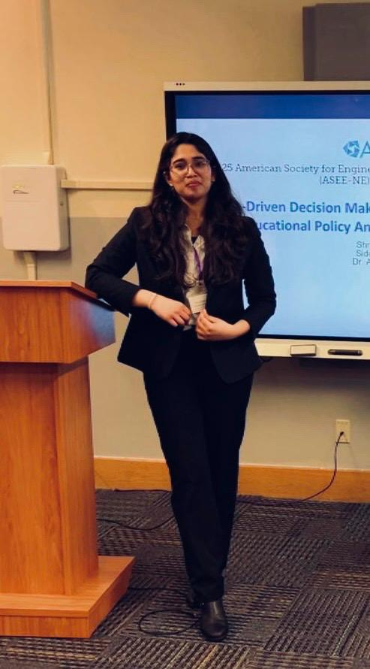
Meet the Team !
Sakshi Shergar
Shruti Brahma
Course: Introduction to Artificial Intelligence (Spring 2025)
Advisor: Dr. Shivanjali Khare
University of New Haven

Slide 2

Akinator
Mind reader
Interactive Character Predictor in Python with a Bayesian Twist and Binary Intelligence

Slide 3



Deliverables
Game
json dataset
guide
Python game script
Character dataset with each character’s unique trait
Methodology, Implementation and Documentation

Slide 4
1.
Implement a game logic that can deduce characters using feature-based filtering
2.
Demonstrate how a hybrid of deterministic logic and probabilistic reasoning can work together
Project Objectives
3.
Apply course learning in some real use.
4.
Use a blend of rule-based filtering and Bayesian probability to something interesting
5.
And of-course to Have fun!

Slide 5
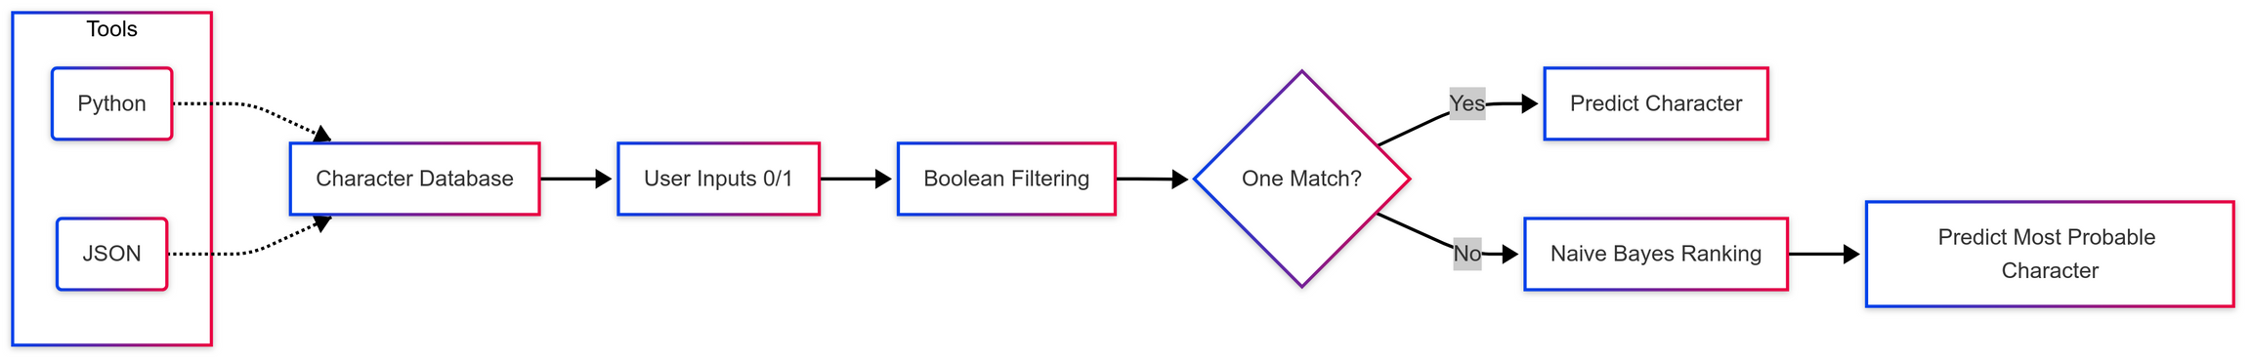
Approach
The project combines rule-based filtering and Naive Bayes inference to guess a character based on user responses.
Characters are represented as binary vectors, and filtering eliminates mismatches at each step.
User responses (0/1) filter out incompatible characters step-by-step.
If multiple candidates remain, Bayesian scoring ranks them to make the most probable guess.
implementation

Slide 6
The project will be evaluated based on:
Correctness: The system correctly identifies the character the user is thinking of.
User experience: The interface is clean, guided, and responsive to input.
Scalability: New characters or questions can be added without rewriting logic.
How to test it:
Pick a character from the list.
Play the game honestly with accurate answers.
Confirm whether the system guesses correctly or narrows down sensibly.
Evaluation Methodology

Slide 7
THank you!
enjoy

